Slide 1
Heart Disease Prevalence and Prediction
1
Anisha Kaul
Prerna Manwani
Susrutha Gongalla
Miranda Nyugen

Slide 2
Questions
What is the prevalence of heart disease in America?
How likely is a person to contract heart disease?
Notes:
People ranging from the age of 30 to 80 can give their characteristics and obtain their risk of being suffering from heart disease. In receiving this personalized assessment, people will be informed to be more active in adopting a lifestyle and behaviors that support cardiovascular health.
Develop an understanding of what factors/negative behaviors contribute to heart disease??

Slide 3
Product
Interactive Visualizations
of heart disease mortality and suffering rates
What is the prevalence of heart diseases in USA?
Predictive Model
that calculates the user’s risk of having heart disease
How likely is a person to contract heart disease?
Notes:
How does your system work
Predictive model to show users the
Interactive visualizations to explore data collected by the CDC and variables related to our prediction model.
We built a web application that lets a user interact with visualizations and explore heart disease datasets
We also built predictive model that the user can use to assess his/her risk of contracting heart disease
How does it answer the question you posed?

Slide 4
Process
Iteration
Data Collection
Data Exploration
Data Cleaning
Modeling & Visualizing
Sketching
D3
HTML/JS
Flask
UCI Dataset
CDC
Kaiser Foundation
R/Python
UCI Dataset
CDC
Kaiser Foundation
Notes:
Summarize in one slide what you did to answer this question.
What are the most important things you learned?
Flow chart:
Survey different datasets to answer our questions
Data Cleaning and check correctness of datasets chosen
Visually explore datasets to detect patterns on variables that affect the risk of suffering from heart disease; age, sex, cholesteral were variables that factored into the
Build a machine learning model based on our exploration that predicts whether a person would suffer from heart disease
Draw inferences from the model results and exploration
=> After prediction with multi-class, we got poor results due to very few data points for each class. Hence we went back to data cleaning and transformed the problem into binary classification, initial prediction
For the purpose of answering our questions, we settled on these datasets. They were the most relevant

Slide 5
Past Work
What answers or partial answers to this question already exist?
Organizations such as the CDC are aware the heart disease is very prevalent, but the general population does not.
What if anything is hard about answering your question
Notes:
A good presentation will show understanding of the underlining challenges with answering the questions, and will provide examples of existing attempts to answer the question and why these answers are lacking. Also, if nobody attempted to answer these questions before, are they really important or even answerable?

Slide 6
Data Collection & Quality
What was your target population?
How closely does your data represent them?
Who collected it?
How reliable is it?
What problems did you discover in the data and how did you address them?
Notes:
A good presentation will explain what you wanted to know and how well your data matches that. It will be specific about where the data came from and discuss any known reliability issues.

Slide 7
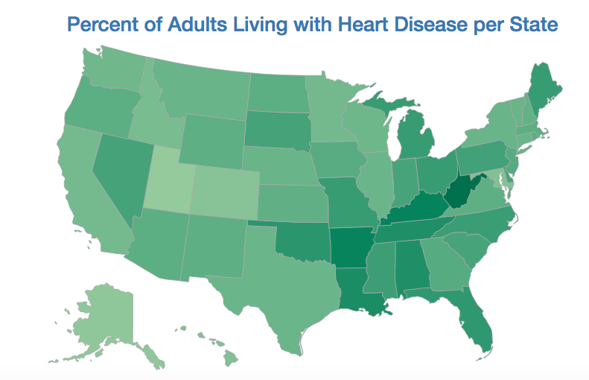
Exploration
Notes:
UTAH

Slide 8
Machine Learning
Notes:
Did you use machine learning? What did you do? Why is it correct? What did you find?
Walk through predictive model page and prediction form

Slide 9
Limitations & Future Work
Small Dataset
Sex Distribution Imbalance
Model Validation
We’re not doctors, users should check in with a real doctor for more certain conclusions and for next steps
Notes:
A good presentation will include a brief discussion about any issues with the system or limits on what it is capable of, how the system could be improved in the future or any new questions that have arisen from the data exploration.

Slide 10
Conclusion
Summary of key points
Future Work
Wearable technology
Temporal Data

Slide 11
Demo

